Slide 1




DIGITAL LITERACY
SKILLS
BASIC USERS

Slide 2
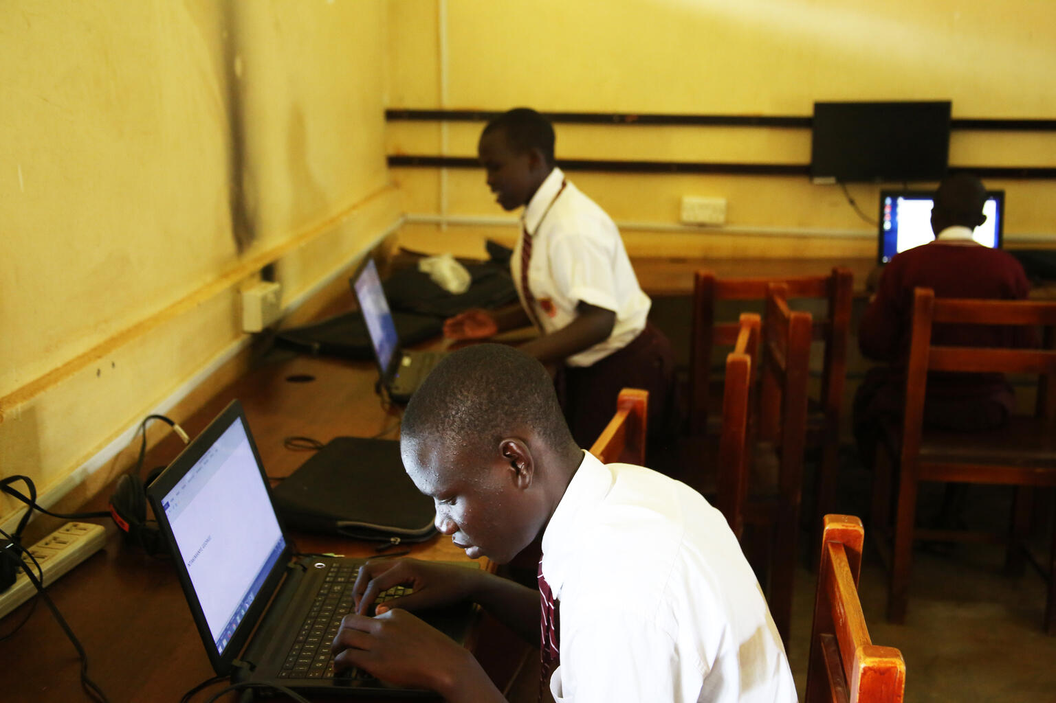
Module 6
Problem solving

Slide 3

1
Unit 1: Solving technical problems

Slide 4
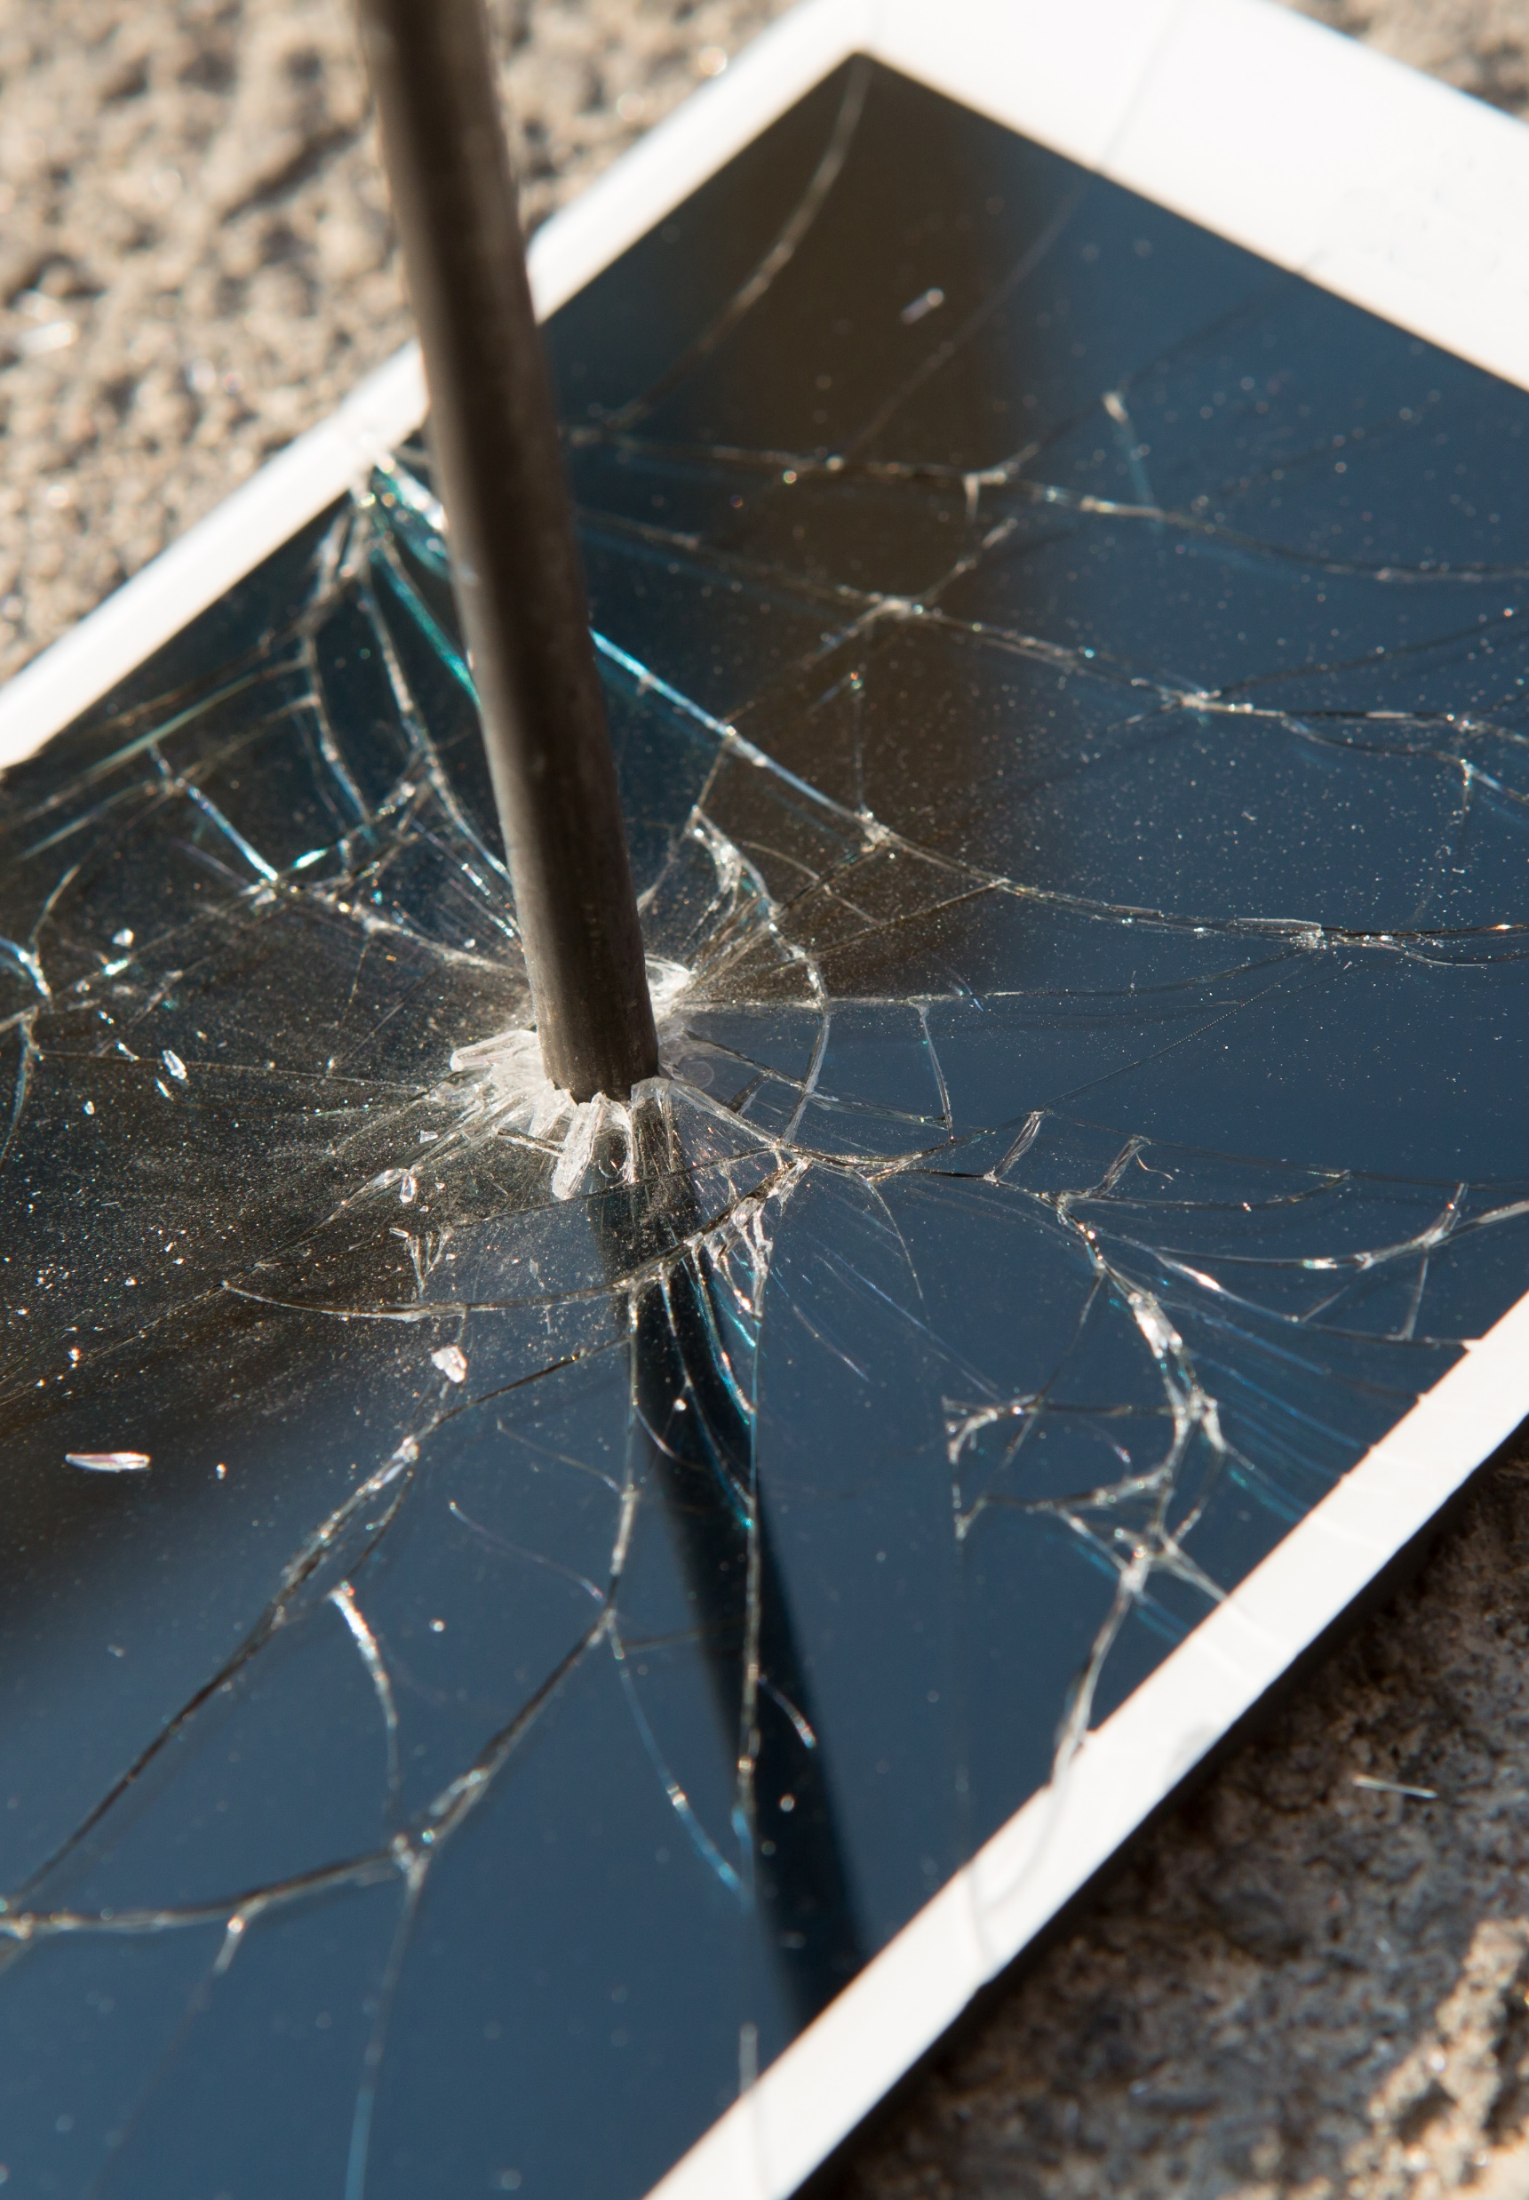
Most common technical problems
The computer won’t start
The screen is blank
Abnormally functioning operating system or software
Windows won’t boot
The screen is frozen
A program on the computer is frozen
Computer is slow
Storage space
Continue >

Slide 5
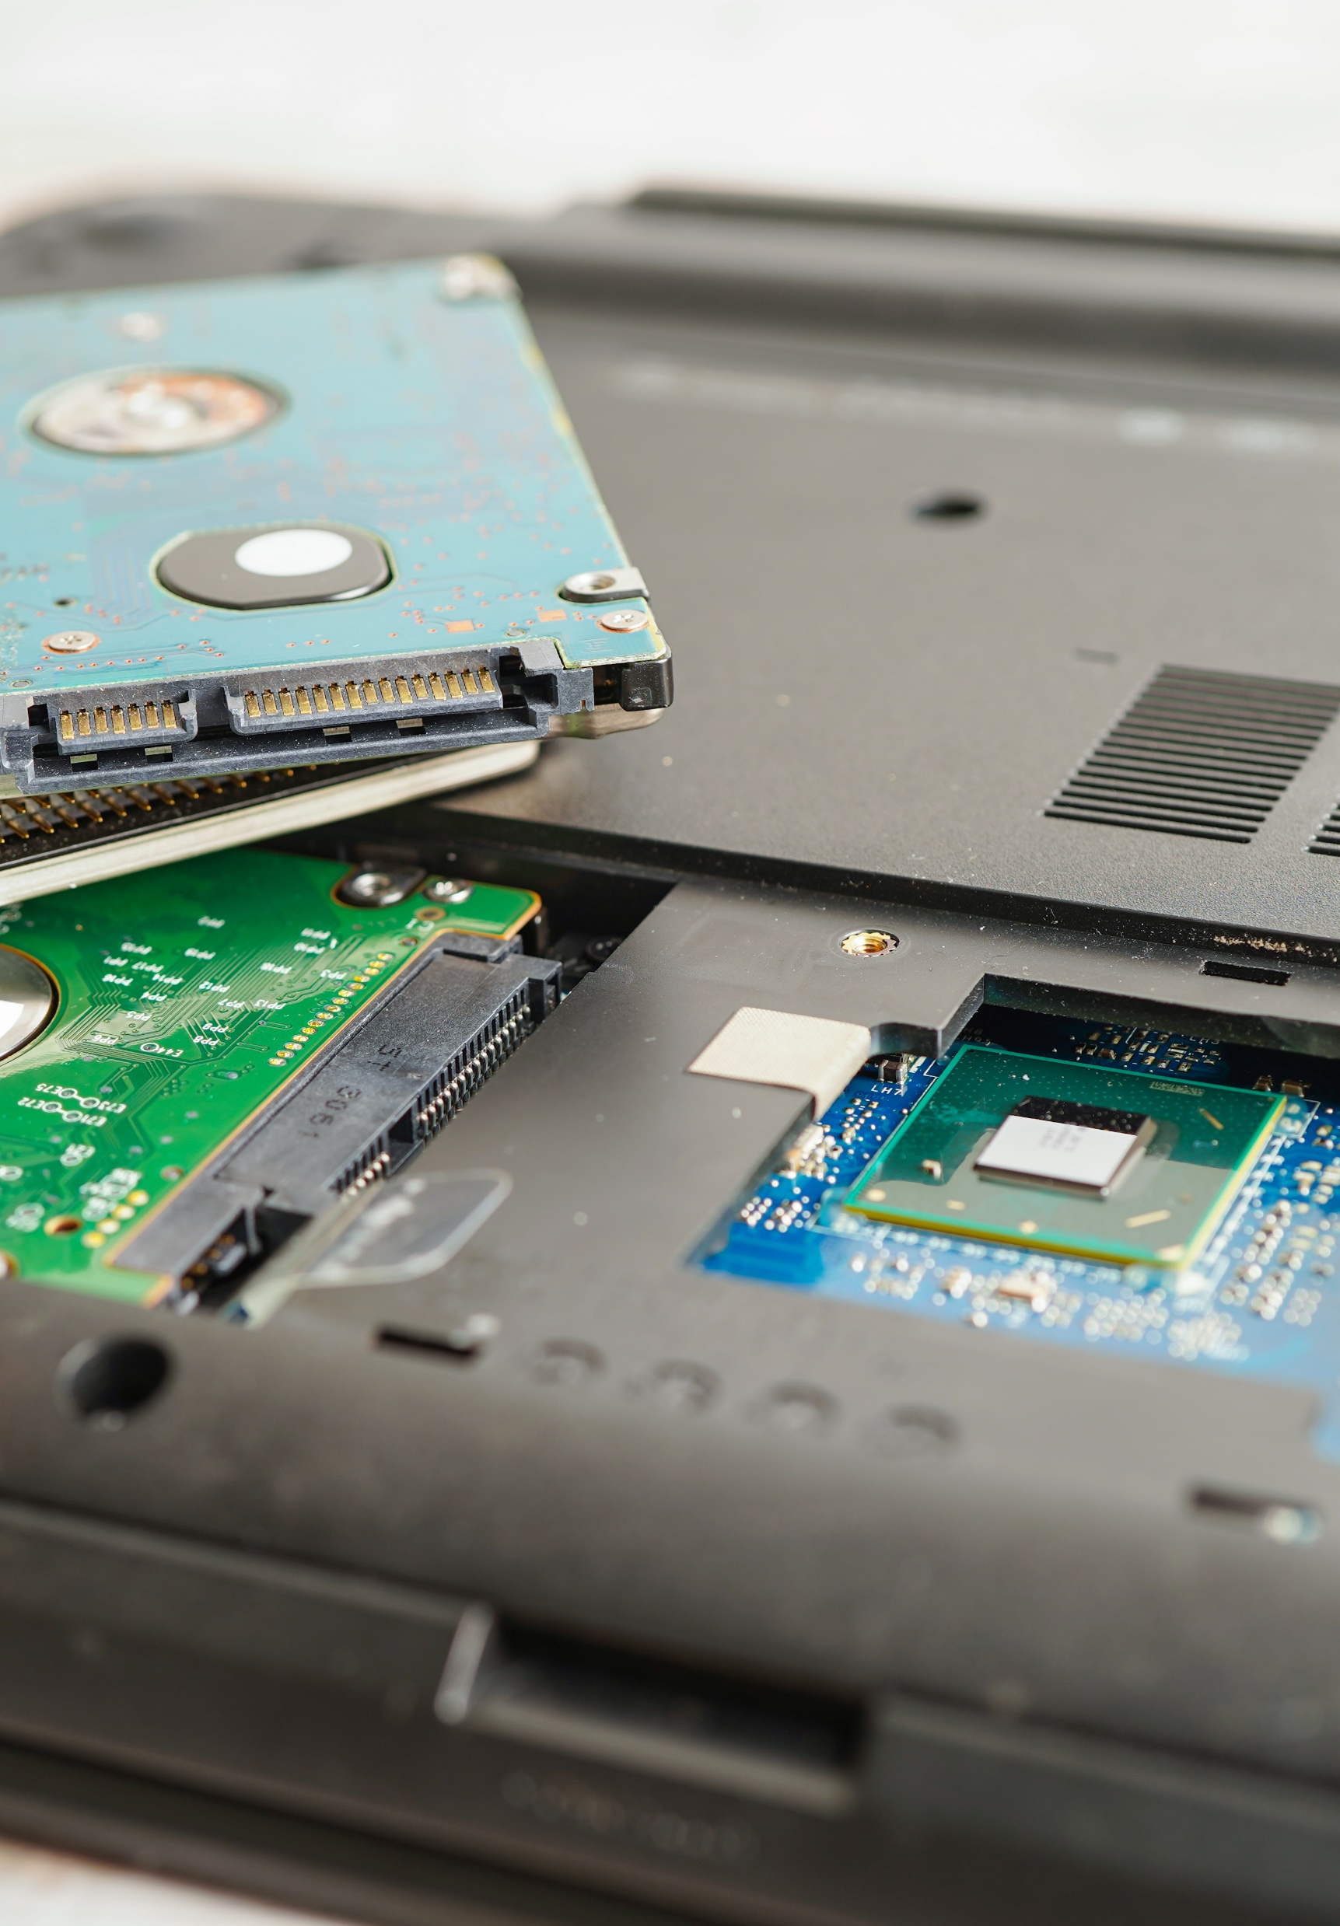
Most common technical problems
Dropped internet connections
Strange noises
Computer overheating
Slow internet
Smartphone is running slowly
Phone or app crashes
Smartphone overheating
Continue >

Slide 6
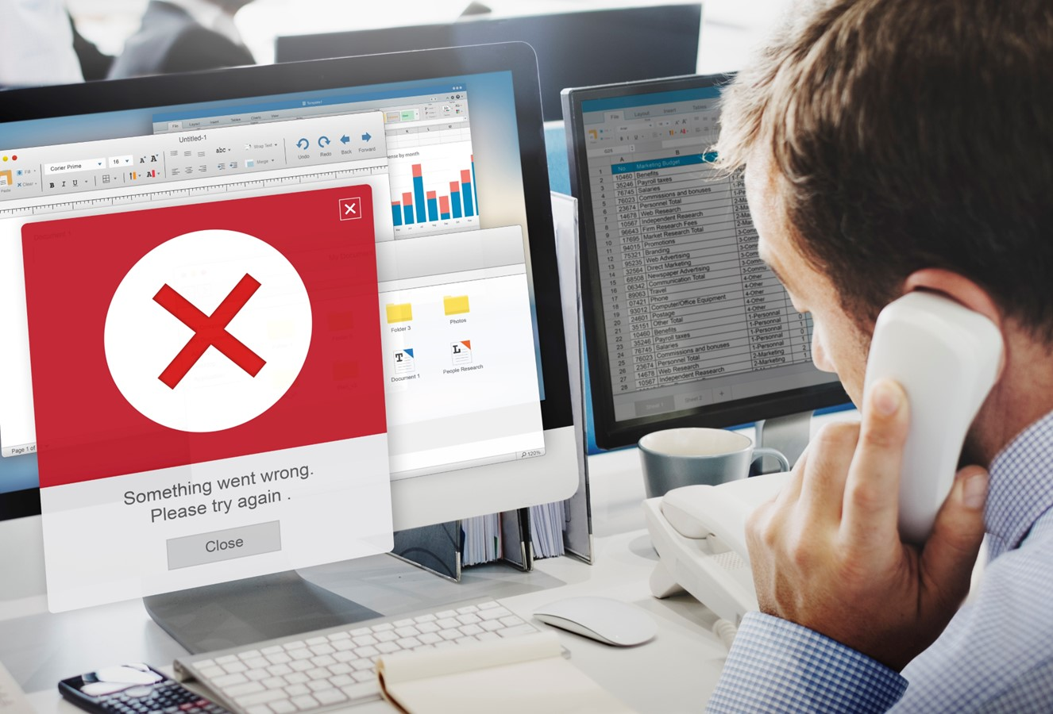
Most common technical problems
Problems connecting with Bluetooth, Wi-Fi, cellular network
Apps not downloading
Synchronization (sync) issue
Cracked screen or immersion in water

Slide 7
Skills to practise
Find support
Think of the devices that you use and the tasks you carry out when using them.
Identify who you would ask for help if you do not know how to complete a task or encounter a problem. It maybe your facilitator or a fellow student who is more skilled than yourself.
2. Solve problems
Check that the battery of your device is charged.
If not, plug in the device so that it can recharge.
Check that your device is connected to the internet. If not, reconnect to the internet and open your internet browser.
Open a document that you have worked on. Make a change and close the document, close the app or program and reopen your document.
Restart your device after closing all programs.

Slide 8
All back covers should include
contact information of the section
producing the work.
© United Nations Children’s Fund (UNICEF) [month and year of publication]

